Slide 1

DIVINE GRACE COLLEGE OF ARTS, SCIENCE AND TECHNOLOGY
(DGCAST) — GAROUA | GEOGRAPHY DEPARTMENT
UPPER SIXTH ARTS — PRACTICAL GEOGRAPHY — MAP ANALYSIS 8
Rural Settlements on Maps
Mr KAMDEM EMMANUEL
Geography Teacher — PLEG
Academic Year 2026 / 2027
Notes:
Good morning, class. Today we study Map Analysis 8: Rural Settlements on Maps.

Slide 2
GEOGRAPHY — UPPER SIXTH ARTS
CLASS INFO
Class, Chapter & Duration
Class | Upper Sixth Arts
Chapter | Module 8: Understanding and carrying out statistical techniques, topographic map analysis, fieldwork and project based learning
Duration | 2 periods (2 × 50 minutes)
2026 / 2027
DGCAST GAROUA — GEOGRAPHY DEPARTMENT
Mr KAMDEM E. | 2

Slide 3
GEOGRAPHY — UPPER SIXTH ARTS
IDENTIFICATION
Lesson Identification
Topic | Topographic Map Analysis
Sub-topic | Settlement Analysis
Lesson | Map Analysis 8: Rural Settlements on Maps
Notions / Concepts | Site, situation, nucleated, linear, dispersed, settlement pattern, Nearest Neighbour Index.
Syllabus focus | Site and situation from map evidence; factors of siting; rural settlement forms and patterns; distribution; Nearest Neighbour Index.
Competence | Learners are able to explain the siting and patterns of rural settlements from maps and calculate the NNI.
2026 / 2027
DGCAST GAROUA — GEOGRAPHY DEPARTMENT
Mr KAMDEM E. | 3

Slide 4
GEOGRAPHY — UPPER SIXTH ARTS
OBJECTIVES
Learning Objectives
By the end of the lesson, the learner should be able to:
Explain the site and situation of settlements from map evidence.
Identify settlement forms and patterns.
Calculate and interpret the Nearest Neighbour Index.
2026 / 2027
DGCAST GAROUA — GEOGRAPHY DEPARTMENT
Mr KAMDEM E. | 4

Slide 5
GEOGRAPHY — UPPER SIXTH ARTS
RECALL
Recall
Villages can be nucleated, linear or dispersed.
NNI measures settlement patterns.
2026 / 2027
DGCAST GAROUA — GEOGRAPHY DEPARTMENT
Mr KAMDEM E. | 5

Slide 6
GEOGRAPHY — UPPER SIXTH ARTS
REAL-LIFE SITUATION
Real-Life Situation
On a map extract, some huts cluster at a river crossing, others line a road and others are scattered on hills. The class must describe and explain these patterns.
2026 / 2027
DGCAST GAROUA — GEOGRAPHY DEPARTMENT
Mr KAMDEM E. | 6
Notes:
Read the situation slowly, twice.

Slide 7
GEOGRAPHY — UPPER SIXTH ARTS
REAL-LIFE SITUATION
Situation — Question 1
What is the problem in the situation?
2026 / 2027
DGCAST GAROUA — GEOGRAPHY DEPARTMENT
Mr KAMDEM E. | 7

Slide 8
GEOGRAPHY — UPPER SIXTH ARTS
REAL-LIFE SITUATION
Answer
The class must explain settlement patterns.
2026 / 2027
DGCAST GAROUA — GEOGRAPHY DEPARTMENT
Mr KAMDEM E. | 8

Slide 9
GEOGRAPHY — UPPER SIXTH ARTS
REAL-LIFE SITUATION
Situation — Question 2
Which pattern is along the road?
2026 / 2027
DGCAST GAROUA — GEOGRAPHY DEPARTMENT
Mr KAMDEM E. | 9

Slide 10
GEOGRAPHY — UPPER SIXTH ARTS
REAL-LIFE SITUATION
Answer
Linear.
2026 / 2027
DGCAST GAROUA — GEOGRAPHY DEPARTMENT
Mr KAMDEM E. | 10

Slide 11
GEOGRAPHY — UPPER SIXTH ARTS
REAL-LIFE SITUATION
Situation — Question 3
Which index measures the pattern?
2026 / 2027
DGCAST GAROUA — GEOGRAPHY DEPARTMENT
Mr KAMDEM E. | 11

Slide 12
GEOGRAPHY — UPPER SIXTH ARTS
REAL-LIFE SITUATION
Possible Answer
The Nearest Neighbour Index (NNI).
2026 / 2027
DGCAST GAROUA — GEOGRAPHY DEPARTMENT
Mr KAMDEM E. | 12

Slide 13
GEOGRAPHY — UPPER SIXTH ARTS
JUSTIFICATION
Justification of the Lesson
This lesson helps us to analyse rural settlements on maps.
2026 / 2027
DGCAST GAROUA — GEOGRAPHY DEPARTMENT
Mr KAMDEM E. | 13

Slide 14
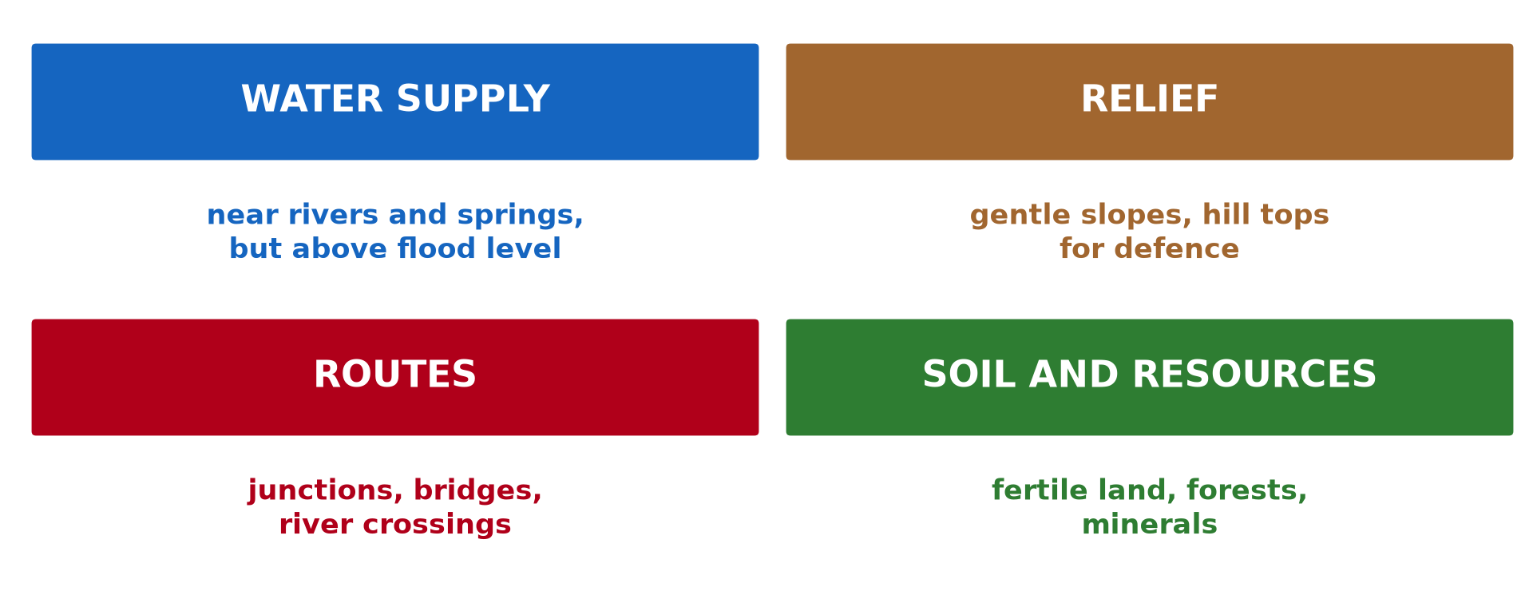
GEOGRAPHY — UPPER SIXTH ARTS
I. SITE FACTORS
Activity 1
Siting factors.
2026 / 2027
DGCAST GAROUA — GEOGRAPHY DEPARTMENT
Mr KAMDEM E. | 14
Notes:
Without the projector: list factors.

Slide 15
GEOGRAPHY — UPPER SIXTH ARTS
I. SITE FACTORS
Activity 1: Question
Give three factors that influence the site of a village.
2026 / 2027
DGCAST GAROUA — GEOGRAPHY DEPARTMENT
Mr KAMDEM E. | 15

Slide 16
GEOGRAPHY — UPPER SIXTH ARTS
I. SITE FACTORS
Answer
Water supply, gentle relief and routes (also fertile soil).
2026 / 2027
DGCAST GAROUA — GEOGRAPHY DEPARTMENT
Mr KAMDEM E. | 16

Slide 17
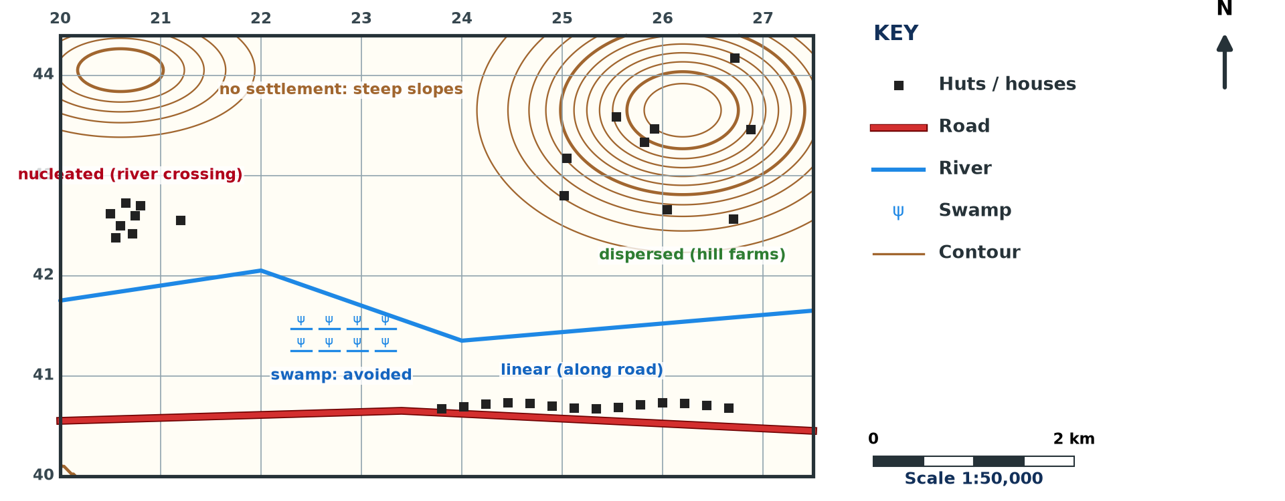
GEOGRAPHY — UPPER SIXTH ARTS
II. FORMS AND PATTERNS
Activity 2
Settlements on a map (invented).
2026 / 2027
DGCAST GAROUA — GEOGRAPHY DEPARTMENT
Mr KAMDEM E. | 17
Notes:
Without the projector: describe the map.

Slide 18
GEOGRAPHY — UPPER SIXTH ARTS
II. FORMS AND PATTERNS
Activity 2: Question
Identify three settlement patterns on the extract.
2026 / 2027
DGCAST GAROUA — GEOGRAPHY DEPARTMENT
Mr KAMDEM E. | 18

Slide 19
GEOGRAPHY — UPPER SIXTH ARTS
II. FORMS AND PATTERNS
Answer
Nucleated at the river crossing, linear along the road and dispersed on the hills.
2026 / 2027
DGCAST GAROUA — GEOGRAPHY DEPARTMENT
Mr KAMDEM E. | 19

Slide 20

GEOGRAPHY — UPPER SIXTH ARTS
II. EXPLANATION
Activity 3
Settlement patterns.
2026 / 2027
DGCAST GAROUA — GEOGRAPHY DEPARTMENT
Mr KAMDEM E. | 20
Notes:
Without the projector: explain gaps.

Slide 21
GEOGRAPHY — UPPER SIXTH ARTS
II. EXPLANATION
Activity 3: Question
Why are there no settlements on steep slopes or swamps?
2026 / 2027
DGCAST GAROUA — GEOGRAPHY DEPARTMENT
Mr KAMDEM E. | 21

Slide 22
GEOGRAPHY — UPPER SIXTH ARTS
II. EXPLANATION
Answer
They are hard to build on, farm and reach; swamps flood.
2026 / 2027
DGCAST GAROUA — GEOGRAPHY DEPARTMENT
Mr KAMDEM E. | 22

Slide 23
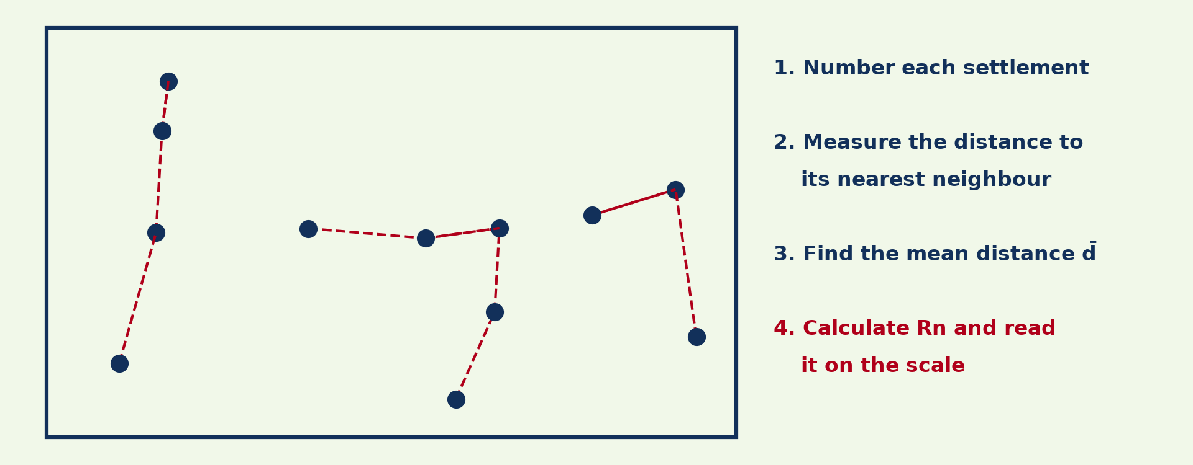
GEOGRAPHY — UPPER SIXTH ARTS
III. NNI METHOD
Activity 4
Measuring nearest neighbours.
2026 / 2027
DGCAST GAROUA — GEOGRAPHY DEPARTMENT
Mr KAMDEM E. | 23
Notes:
Without the projector: list the steps.

Slide 24
GEOGRAPHY — UPPER SIXTH ARTS
III. NNI METHOD
Activity 4: Question
Write the NNI formula.
2026 / 2027
DGCAST GAROUA — GEOGRAPHY DEPARTMENT
Mr KAMDEM E. | 24

Slide 25
GEOGRAPHY — UPPER SIXTH ARTS
III. NNI METHOD
Answer
Rn = 2 d̄ √(n ÷ A).
2026 / 2027
DGCAST GAROUA — GEOGRAPHY DEPARTMENT
Mr KAMDEM E. | 25

Slide 26
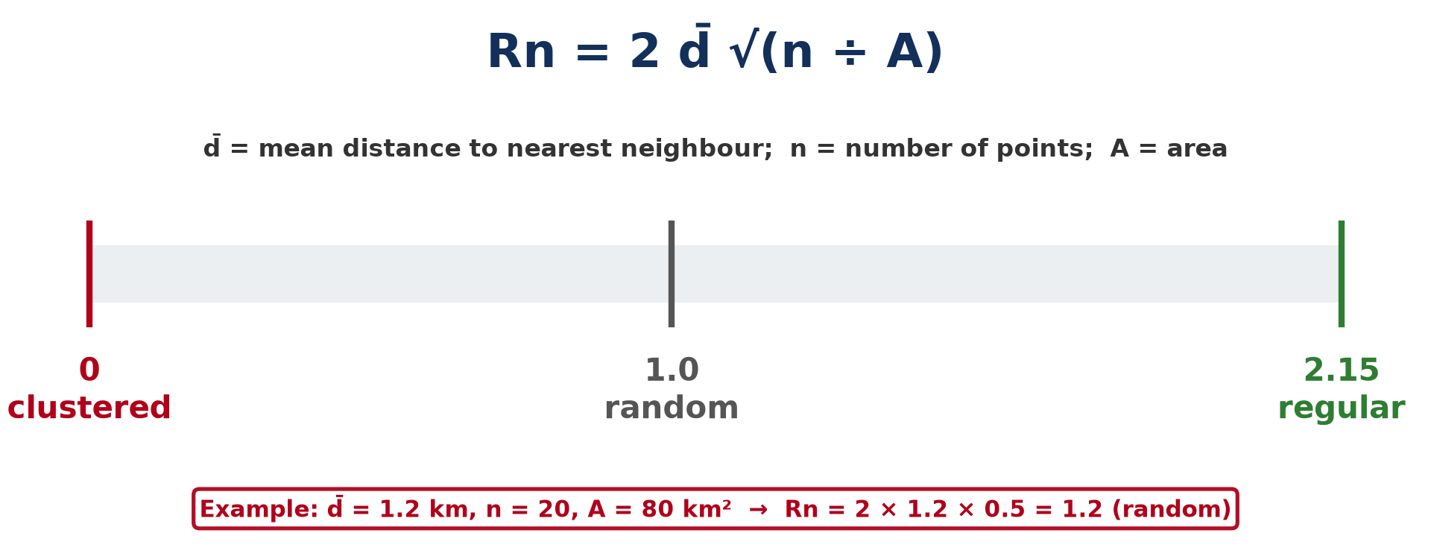
GEOGRAPHY — UPPER SIXTH ARTS
III. NNI INTERPRETATION
Activity 5
NNI scale.
2026 / 2027
DGCAST GAROUA — GEOGRAPHY DEPARTMENT
Mr KAMDEM E. | 26
Notes:
Without the projector: read the scale.

Slide 27
GEOGRAPHY — UPPER SIXTH ARTS
III. NNI INTERPRETATION
Activity 5: Question
Interpret Rn = 0.4 and Rn = 1.8.
2026 / 2027
DGCAST GAROUA — GEOGRAPHY DEPARTMENT
Mr KAMDEM E. | 27

Slide 28
GEOGRAPHY — UPPER SIXTH ARTS
III. NNI INTERPRETATION
Answer
0.4: clustered (nucleated). 1.8: fairly regular (dispersed).
2026 / 2027
DGCAST GAROUA — GEOGRAPHY DEPARTMENT
Mr KAMDEM E. | 28

Slide 29
GEOGRAPHY — UPPER SIXTH ARTS
BOARD SUMMARY
Rural Settlements on Maps
Topic: Topographic Map Analysis
Sub-topic: Settlement Analysis
Map Analysis 8: Rural Settlements on Maps
2026 / 2027
DGCAST GAROUA — GEOGRAPHY DEPARTMENT
Mr KAMDEM E. | 29
Notes:
Learners copy the board summary now. Give them enough time for each slide.

Slide 30
GEOGRAPHY — UPPER SIXTH ARTS
BOARD SUMMARY
I. Definitions
Site: It is the actual land on which a settlement is built.
Situation: It is the position of a settlement in relation to the surrounding area.
Nearest Neighbour Index: It is a number from 0 to 2.15 that measures the pattern of settlements.
2026 / 2027
DGCAST GAROUA — GEOGRAPHY DEPARTMENT
Mr KAMDEM E. | 30

Slide 31
GEOGRAPHY — UPPER SIXTH ARTS
BOARD SUMMARY
II. Siting and Patterns (1/3)
A. Siting: Map evidence shows villages near water, on gentle slopes and at route junctions. Swamps and steep slopes are avoided.
B. Forms: Settlements can be nucleated, linear or dispersed. Linear settlements follow roads, rivers or ridges.
2026 / 2027
DGCAST GAROUA — GEOGRAPHY DEPARTMENT
Mr KAMDEM E. | 31

Slide 32
GEOGRAPHY — UPPER SIXTH ARTS
BOARD SUMMARY
II. Siting and Patterns (2/3)
C. Distribution: Describe where settlements are dense or absent. Explain with relief, drainage and routes.
2026 / 2027
DGCAST GAROUA — GEOGRAPHY DEPARTMENT
Mr KAMDEM E. | 32

Slide 33
GEOGRAPHY — UPPER SIXTH ARTS
BOARD SUMMARY
II. Siting and Patterns (3/3)
Sketch the patterns.
2026 / 2027
DGCAST GAROUA — GEOGRAPHY DEPARTMENT
Mr KAMDEM E. | 33

Slide 34
GEOGRAPHY — UPPER SIXTH ARTS
BOARD SUMMARY
III. Nearest Neighbour Index
A. Method: Measure each settlement's distance to its nearest neighbour and find the mean d̄. Rn = 2 d̄ √(n ÷ A).
B. Interpretation: Rn near 0 is clustered, 1.0 is random and 2.15 is perfectly regular. Relate the result to map evidence.
2026 / 2027
DGCAST GAROUA — GEOGRAPHY DEPARTMENT
Mr KAMDEM E. | 34

Slide 35
GEOGRAPHY — UPPER SIXTH ARTS
FORMATIVE EVALUATION
Formative Evaluation 1
n = 16, A = 16 km², d̄ = 0.5 km. Find Rn.
2026 / 2027
DGCAST GAROUA — GEOGRAPHY DEPARTMENT
Mr KAMDEM E. | 35

Slide 36
GEOGRAPHY — UPPER SIXTH ARTS
FORMATIVE EVALUATION
Expected Answer
2 × 0.5 × √(16 ÷ 16) = 1.0: random.
2026 / 2027
DGCAST GAROUA — GEOGRAPHY DEPARTMENT
Mr KAMDEM E. | 36

Slide 37
GEOGRAPHY — UPPER SIXTH ARTS
FORMATIVE EVALUATION
Formative Evaluation 2
Give two reasons for linear settlements.
2026 / 2027
DGCAST GAROUA — GEOGRAPHY DEPARTMENT
Mr KAMDEM E. | 37

Slide 38
GEOGRAPHY — UPPER SIXTH ARTS
FORMATIVE EVALUATION
Expected Answer
Along roads for transport and along rivers for water.
2026 / 2027
DGCAST GAROUA — GEOGRAPHY DEPARTMENT
Mr KAMDEM E. | 38

Slide 39
GEOGRAPHY — UPPER SIXTH ARTS
REMEDIATION
Remediation
Fill in the blanks:
The land a village is built on is its ______.
Rn = 1.0 means ______.
Huts along a road form a ______ pattern.
2026 / 2027
DGCAST GAROUA — GEOGRAPHY DEPARTMENT
Mr KAMDEM E. | 39
Notes:
Answers: 1. site 2. random 3. linear

Slide 40
GEOGRAPHY — UPPER SIXTH ARTS
HOMEWORK
Homework
Calculate the NNI for the huts in one grid square of a map extract.
This prepares Map Analysis 9: Urban Settlements on Maps.
2026 / 2027
DGCAST GAROUA — GEOGRAPHY DEPARTMENT
Mr KAMDEM E. | 40
Notes:
This homework prepares the next lesson.

Slide 41
GEOGRAPHY — UPPER SIXTH ARTS
BILINGUAL GAME
Bilingual Game (Jeu Bilingue)
English | Français
Village | Le village
Site | Le site
Pattern | La forme de répartition
Nucleated | Groupé
Dispersed | Dispersé
Linear | Linéaire
2026 / 2027
DGCAST GAROUA — GEOGRAPHY DEPARTMENT
Mr KAMDEM E. | 41
Notes:
Say the English word; learners give the French word, then the reverse.

Slide 42
GEOGRAPHY — UPPER SIXTH ARTS
LOGBOOK
Official Logbook (1/2)
Module / Topic | Topographic Map Analysis
Lesson Title | Map Analysis 8: Rural Settlements on Maps
Expected Learning Outcomes | Explain the site and situation of settlements from map evidence. Identify settlement forms and patterns. Calculate and interpret the Nearest Neighbour Index.
Competence | Learners are able to explain the siting and patterns of rural settlements from maps and calculate the NNI.
2026 / 2027
DGCAST GAROUA — GEOGRAPHY DEPARTMENT
Mr KAMDEM E. | 42

Slide 43
GEOGRAPHY — UPPER SIXTH ARTS
LOGBOOK
Official Logbook (2/2)
Matter Taught | I. Definitions: Site, Situation, Nearest Neighbour Index; II. Siting and Patterns: Siting, Forms, Distribution; III. Nearest Neighbour Index: Method, Interpretation.
Evaluation | Formative evaluation (3 questions) and remediation exercise.
Homework | Calculate the NNI for the huts in one grid square of a map extract.
Enrolment / Present / Absent | ____ / ____ / ____
Achievement | To be completed by the teacher after the lesson.
2026 / 2027
DGCAST GAROUA — GEOGRAPHY DEPARTMENT
Mr KAMDEM E. | 43

Slide 44
GEOGRAPHY — UPPER SIXTH ARTS
TEACHER'S NOTE
Teacher's Note
Timing: Set-up, recall 8 min | Situation 8 min | 5 activities 30 min | Board summary (copying) 30 min | Evaluation, remediation 10 min | Homework, logbook 9 min | Spare 5 min
2026 / 2027
DGCAST GAROUA — GEOGRAPHY DEPARTMENT
Mr KAMDEM E. | 44

Slide 45
GEOGRAPHY — UPPER SIXTH ARTS
REFERENCES
References
National Geography Syllabus, Sixth Forms (Lower & Upper Sixth), MINESEC/IGE/IP-SS, August 2019 — Module 8 (Practical Geography).
Diagrams and animations: drawn for this lesson (DGCAST Geography Department).
2026 / 2027
DGCAST GAROUA — GEOGRAPHY DEPARTMENT
Mr KAMDEM E. | 45

